Slide 1
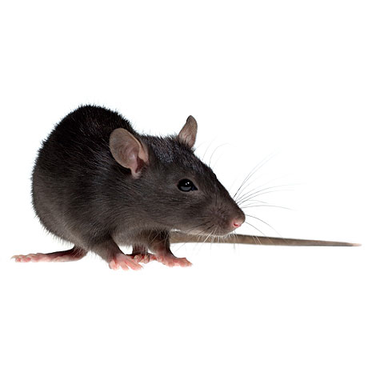
2 unit of
Energy with
p=1
8 units of
Energy with
p=0.25
Small-outcome state
Big-outcome state
Place preference
2 units of
energy
Internal state
Trial
Simulation specifications:
average over 2000 runs
algorithm: Q-learning + softmax
alpha = 0.25
beta = 10
gamma = 0.8
m = 2
n = 4
initial internal state = 0 optimal internal state = 0
big outcome = 8
small outcome = 2
energy expenditure per step = 2

